Slide 1
network software architecture project AUDIO System
GROUP 5
Chu Quoc Hung
Nguyen ngoc thanh
Nguyen dinh hai nam

Slide 2
OUTLINE
introduction
Functionalities
Architecture
demo

Slide 3
OUTLINE
introduction
Functionalities
Architecture
DEMO

Slide 4
introduction
Audio system simulator
Upnp-compatible
Language: JAVA
Libraries: javafx, cling

Slide 5
OUTLINE
introduction
Functionalities
Architecture
DEMO

Slide 6
Functionalities main functions
Power on/off
Play music
Play/pause
Change current track
Set stop timer

Slide 7
Functionalities main functions
Audio control
volume
bass level
treble level
3 Audio mode: NORMAL, POP, rock

Slide 8
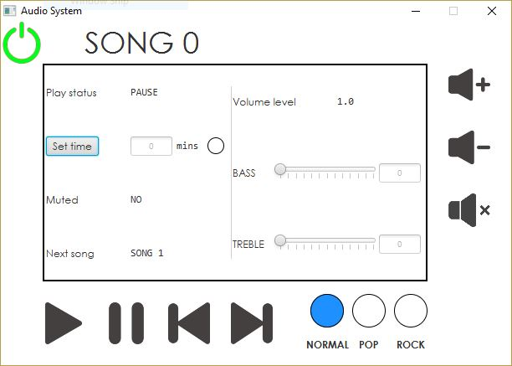
Functionalities ui design

Slide 9
Functionalities unpn compatibility
2 ways to control the system
Using the user interface
via the network using other control points
WHEN CONTROL POINT INVOKE ACTION: change status & VIEW
Dispatch event when status changed

Slide 10
OUTLINE
introduction
Functionalities
Architecture
demo

Slide 11
Architecture main components
Controller
Contains upnp service instance
Dispatch actions, receive events
Notify changes to view
VIEW
Handle UI events
Call controller to update status
Contains media player to play music

Slide 12
Architecture upnp services
Switch power
Status: boolean
Play music
Play status: boolean
Timer status: boolean
Track no: int
Timer value: int
Audio control
Volume: int
Bass level: int
Treble level: int
audio mode: enum

Slide 13
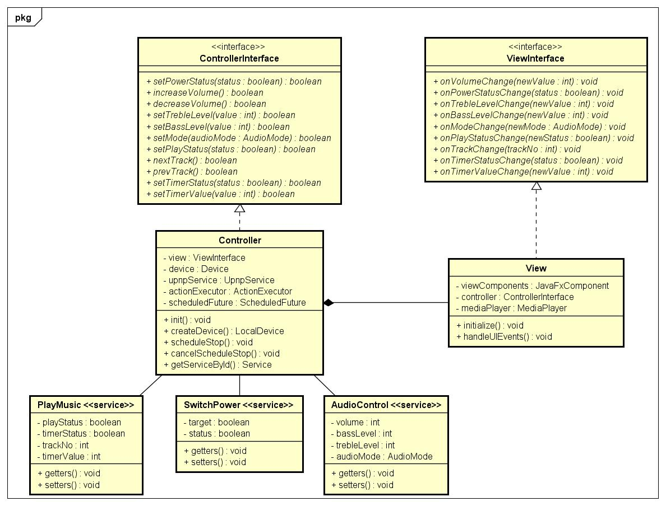
Architecture class DIAGRAM

Slide 14
OUTLINE
introduction
Functionalities
Architecture
demo

Slide 15
Application demo & CODE REVIEW

Slide 16
QUESTIONs & ANSWERs

Slide 17
Thank you for your attention !

